Slide 1
Aggregation and Degradation in JetStream: Streaming Analytics in the Wide Area
Ariel Rabkin
Princeton University
asrabkin@cs.princeton.edu
Work done with Matvey Arye, Siddhartha Sen, Vivek S. Pai, and Michael J. Freedman

Slide 2
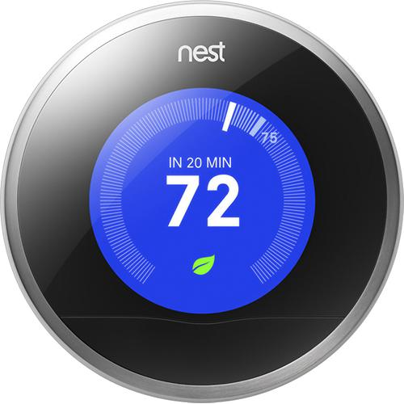

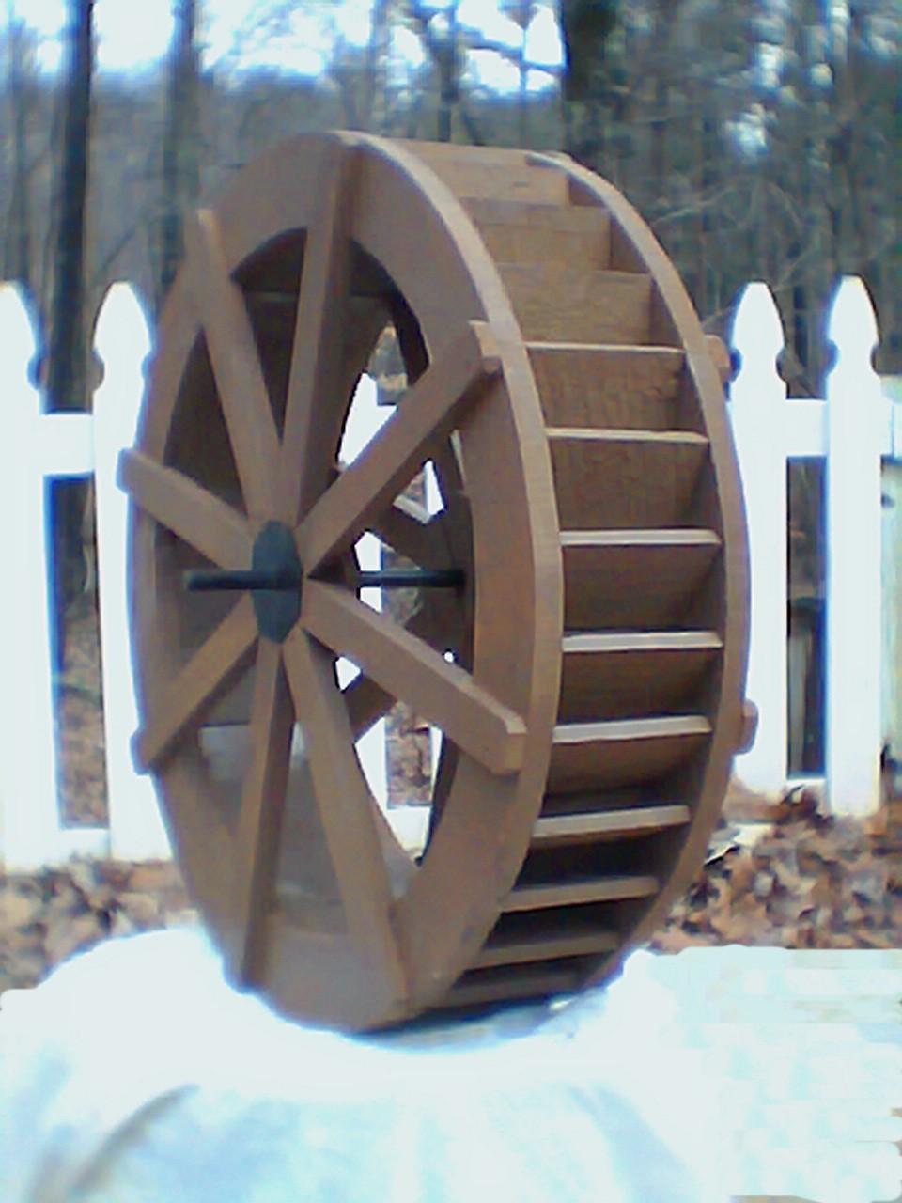



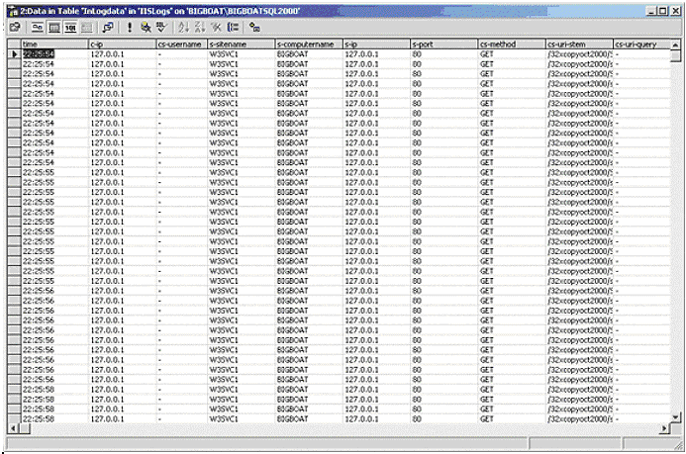
Today’s Analytics Architectures
MillWheel
(Google)
Storm
Backhaul is inefficient and inflexible
Notes:
Stream-processing systems have become a fundamental building block of modern large-scale software systems. This talk describes how to apply this paradigm to the wide area, where bandwidth is unreliable and scarce.

Slide 3
Tomorrow’s Architecture: JetStream
JetStream
Backhaul is inefficient and inflexible
Goal: optimize use of WAN links by exposing them to streaming system.
Notes:
Stream-processing systems have become a fundamental building block of modern large-scale software systems. This talk describes how to apply this paradigm to the wide area, where bandwidth is unreliable and scarce.

Slide 4
Backhaul is Intrinsically Inefficient
Needed for backhaul
Bandwidth
Available
Time [two days]
Buyer’s remorse: wasted bandwidth
Analyst’s remorse: system overload or
missing data

Slide 5
Stream Processing Basics
Stream Operators
Stream Operators
Site A
Input Data
Site C
Stream Operator
Stream Operators
Stream Operators
Input Data
Site B
Some Operators in JetStream:
Filtering (count > 100)
Sampling (drop 90% of data)
Image Compression
Quantiles (95th percentile)
Query stored data

Slide 6
The JetStream System
  What: Streaming with aggregation and degradation as first-class primitives
  Where: Storage and processing at edge
  Why: Maximize goodput using aggregation and degradation
  How: Data cubes and feedback control

Slide 7
An Example Query
Requests
Requests
CDN Requests
How popular is
every URL?
Requests
Requests
CDN Requests

Slide 8
Mechanism 1: Storage with Aggregation
Requests
Local
Aggregation and Storage
Requests
CDN Requests
Every minute, compute request counts by URL
Requests
Local
Aggregation and Storage
Requests
CDN Requests

Slide 9
Mechanism 2: Adaptive Degradation
Requests
Local
Aggregation and Storage
Adjustable Filtering
Requests
CDN Requests
Every minute, compute request counts by URL
Requests
Local
Aggregation and Storage
Requests
Adjustable Filtering
CDN Requests

Slide 10
Requirements for Storage Abstraction
Update-able (locally and incrementally)
Stored Data
+=
Data
Data size is reducible (with predictable accuracy cost)
Data
Data
Merge-able (without accuracy penalty)
Data
Data
Merged Representation
+
=

Slide 11
The Data Cube Model
Cube: A multidimensional array, indexed by a set of dimensions, whose cells hold aggregates.
Aggregation used for:
Updates
Roll-ups
Merging cubes
Summarizing cubes
Counts by URL | 12:00 | 12:01 | 12:02
www.mysite.com/a | 3 | 5 | 0
www.mysite.com/b | 0 | 2 | 0
www.yoursite.com | 5 | 4 | …
www.her-site.com | 8 | 12 | …
Cubes have aggregation function: Agg( , )→
Notes:
We adapted this abstraction from OLAP databases. Unlike OLAP, we are just keeping a primary-key index, so inserts are cheap and efficient.

Slide 12
Cubes can be “Rolled Up”
Cube: A multidimensional array, indexed by a set of dimensions, whose cells hold aggregates.
Counts by URL | 12:00 | 12:01 | 12:02
www.mysite.com/a | 3 | 5 | 0
www.mysite.com/b | 0 | 2 | 0
www.yoursite.com | 5 | 4 | …
www.her-site.com | 8 | 12 | …
Counts by URL | *
www.mysite.com/a | 8
www.mysite.com/b | 2
www.yoursite.com | 9
www.her-site.com | 20
Counts by URL | 12:00 | 12:01 | 12:02
* | 16 | 23 | …

Slide 13
Cubes Unify Storage and Aggregation
Standing Query
Update sent downstream
Update
Stored Data
Update
Update
One-off query

Slide 14

Degradation: The Big Picture
Local Data
Summarized or Approximated
Data
Network
Dataflow
Operators
Dataflow
Operators
Feedback control
Level of degradation auto-tuned to match bandwidth.
Challenge: Supporting mergeability and flexible policies

Slide 15
Mergeability Imposes Constraints
Every 5
01 - 05
06 - 10
11 - 15
16 - 20
21 - 25
26 - 30
??????
Every 6
01 - 06
07 - 12
13 - 18
19 - 24
25 - 30
Every 5
02 - 06
07 - 11
12 - 16
17 - 21
22 - 26
27 - 31
Every 30??
01 - 30
Every 10
01 - 10
11 - 20
21 - 30
Insight: Degradation may be discontinuous
Notes:
This is an consequence of the problem space, not our design. If you have fidelity changes over time, you have to deal with this sort of thing.
Part of the challenge for our design is to compensate for these difficulties and shield the user.

Slide 16
There Are Many Ways to Degrade Data
Can coarsen a dimension
Can drop low-rank values

Slide 17

Coarsening Does Not Always Help

Slide 18
Degradations Have Trade-offs
Name | Fixed BW Savings | Fixed Accuracy cost | Parameter
Dim. Coarsening | Usually no | Yes | Dimension Scale
Drop values (locally) | Yes | No | Cut-off
Drop values (globally) | No, multi-round protocol | Yes | Cut-off
Audiovisual downsampling | Yes | Yes | Sample rate
Histogram Coarsening | Yes | Yes | Number of Buckets
Notes:
The cube data model gives a nice intuition here: transforming aggregates can have predictable bandwidth and accuracy results; transforming dimensions won’t.

Slide 19
A Simple Idea that Does Not Work
Incoming data
Network
Coarsening Operator
Sampled
Data
Increase aggregation period up to 10 sec. If insufficient, use sampling
Sending 4x too much
We have sensors that report congestion….
Have operators read sensor and adjust themselves?

Slide 20
Challenge: Composite Policies
Incoming data
Network
Coarsening Operator
Sampling Operator
Sending 4x too much
Chaos if two operators are simultaneously responding to the same sensor

Slide 21
Interfacing with Operators
Incoming data
Network
Coarsening Operator
Sampling Operator
Controller
Shrinking data by 50%
Possible levels:
[0%, 50%, 75%, 95%, …]
Sending 4x too much
Go to level 75%

Slide 22
Experimental Setup
80 nodes on VICCI testbed at three sites (Seattle, Atlanta, and Germany)
Princeton
Policy: Drop data if insufficient BW
Notes:
DO NOT Say “son of planelab” -- ke

Slide 23
Without Degradation
Drop BW
Maximum latency
95th percentile latency
Median Latency

Slide 24
Degradation Keeps Latency Bounded
Bandwidth Shaping
95th percentile latency
Median Latency

Slide 25
Showing maximum latencies
Maximum Latency
95th percentile latency
Median Latency

Slide 26
Programming Ease
Scenario | Lines of code
Slow requests | 5
Requests by URL | 5
Bandwidth by node | 15
Bad referrers | 16
Latency and size quantiles | 25
Success by domain | 30
Top 10 domains by period | 40
Big Requests | 97
Notes:
Coded up eight queries based on operational experience with coral. Some were simple, like the requests by URL. Some were hard, like pulling back full logs on the requests above a quantile.

Slide 27
Conclusions and Future Work
Useful to embed aggregation and degradation abstractions in streaming systems.
Aggregation can be unified with storage.
System must accommodate degradation semantics.
Open questions:
  How to guide users to the right degradation policy?
  How to embed abstractions in higher-level language?

Slide 28
Backup slides start here

Slide 29

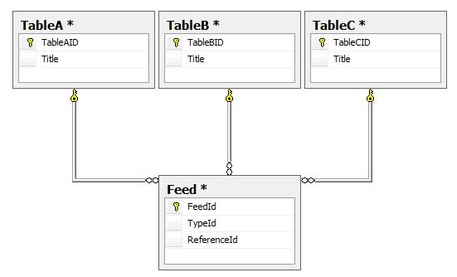
Merge + Aggregate | High-level API | Predictable performance | Arbitrary Joins
X | X | √ | X
X | √ | X | √
√ | √ | √ | X
Raw byte strings
e.g. key-value store
Database tables
Data Cube
Notes:
Clarify Api level: “A short SQL statement can compile to a longish string of MR programs. The reverse is not true”

Slide 30
Merge + Aggregate | High-level API | Predictable performance | Arbitrary Joins
X | X | √ | X
X | √ | X | √
√ | √ | √ | X
Raw byte strings
e.g. key-value store
Database tables
Data Cube
Notes:
Clarify Api level: “A short SQL statement can compile to a longish string of MR programs. The reverse is not true”

Slide 31
Merge + Aggregate | High-level API | Predictable performance | Arbitrary Joins
X | X | √ | X
X | √ | X | √
√ | √ | √ | X
Raw byte strings
e.g. key-value store
Database tables
Data Cube
Notes:
Clarify Api level: “A short SQL statement can compile to a longish string of MR programs. The reverse is not true”

Slide 32
Comparing Multiple Degradations

Slide 33
Introducing a Controller
Incoming data
Network
Coarsening Operator
Sampling Operator
Controller
Drop 75% of data!
Sending 4x too much
Introduce a controller for each network connection that determines which degradations to apply
Degradation policies for each controller
Policy no longer constrained by operator topology

Slide 34
What Happens During Overload?
Needed for backhaul
Bandwidth
Available
? ? ? ? ? ?
Time [one day]
Latency
Queue size grows without bound!
Time

Slide 35
Related Work
Borealis: Shows how to do reliable streaming
SparkStreaming, MillWheel, Storm: Show how to manage recovery and scalability within datacenter. Do not address unreliable or constrained links.
BlinkDB: Degrades data for performance; assumes ability to precompute samples.

Slide 36

System Architecture
Query graph
Optimized query
…
…
JetStream API
…
Planner Library
Coordinator
Daemon
Control plane
worker node
Data plane
…
compute resources (several sites)
stream source

Slide 37
An Example Query
Local Storage
File Read Operator
Parse Log File
Query
Every 10 s
Site A
Central Storage
Site C
Site B
Local
Storage
File Read Operator
Parse Log File
Query
Every 10 s

Slide 38
JetStream is Straightforward to Program
Scenario | Lines of code | BW savings
Big Requests | 97 | 22x
Slow requests | 5 | 24x
Requests by URL | 5 | 351x
Success by domain | 30 | 445x
Latency and size quantiles | 25 | 715x
Top 10 domains by period | 40 | 2300x
Bad referrers | 16 | 18600x
Bandwidth by node | 15 | 49800x

Slide 39
The JetStream Vision
Needed for backhaul
Bandwidth
Used by JetStream
Available
Time [two days]
JetStream lets programs adapt to shortages and backfill later.
Need new programming abstractions.

Slide 40
Contributions
Storage abstraction that allows flexible aggregation inside the streaming system
Dynamic adjustment of data quality to match bandwidth
Notes:
http://qeisecurity.com/wp-content/uploads/2009/12/Camera_WallMt_Panasonic.jpg

Slide 41
Bandwidth Costs
Amazon EC2 bandwidth: $0.05 per GB
Wireless broadband: $2 per GB
Cell phone broadband (ATT/Verizon): $6 per GB
  (Other providers are similar)
Satellite Bandwidth $200 - $460 per GB
  May drop to ~$20
Notes:
http://aws.amazon.com/s3/pricing/
http://www.rogers.com/web/Rogers.portal?_nfpb=true&_pageLabel=Home
http://groundcontrol.com/FleetBroadband_Service_Plans.htm
http://gigaom.com/2012/09/19/why-your-in-flight-wi-fi-is-slow-and-expensive-its-all-about-the-pipe/

